Slide 1
Agricultural Involution
Rice Cultures 2019

Slide 2
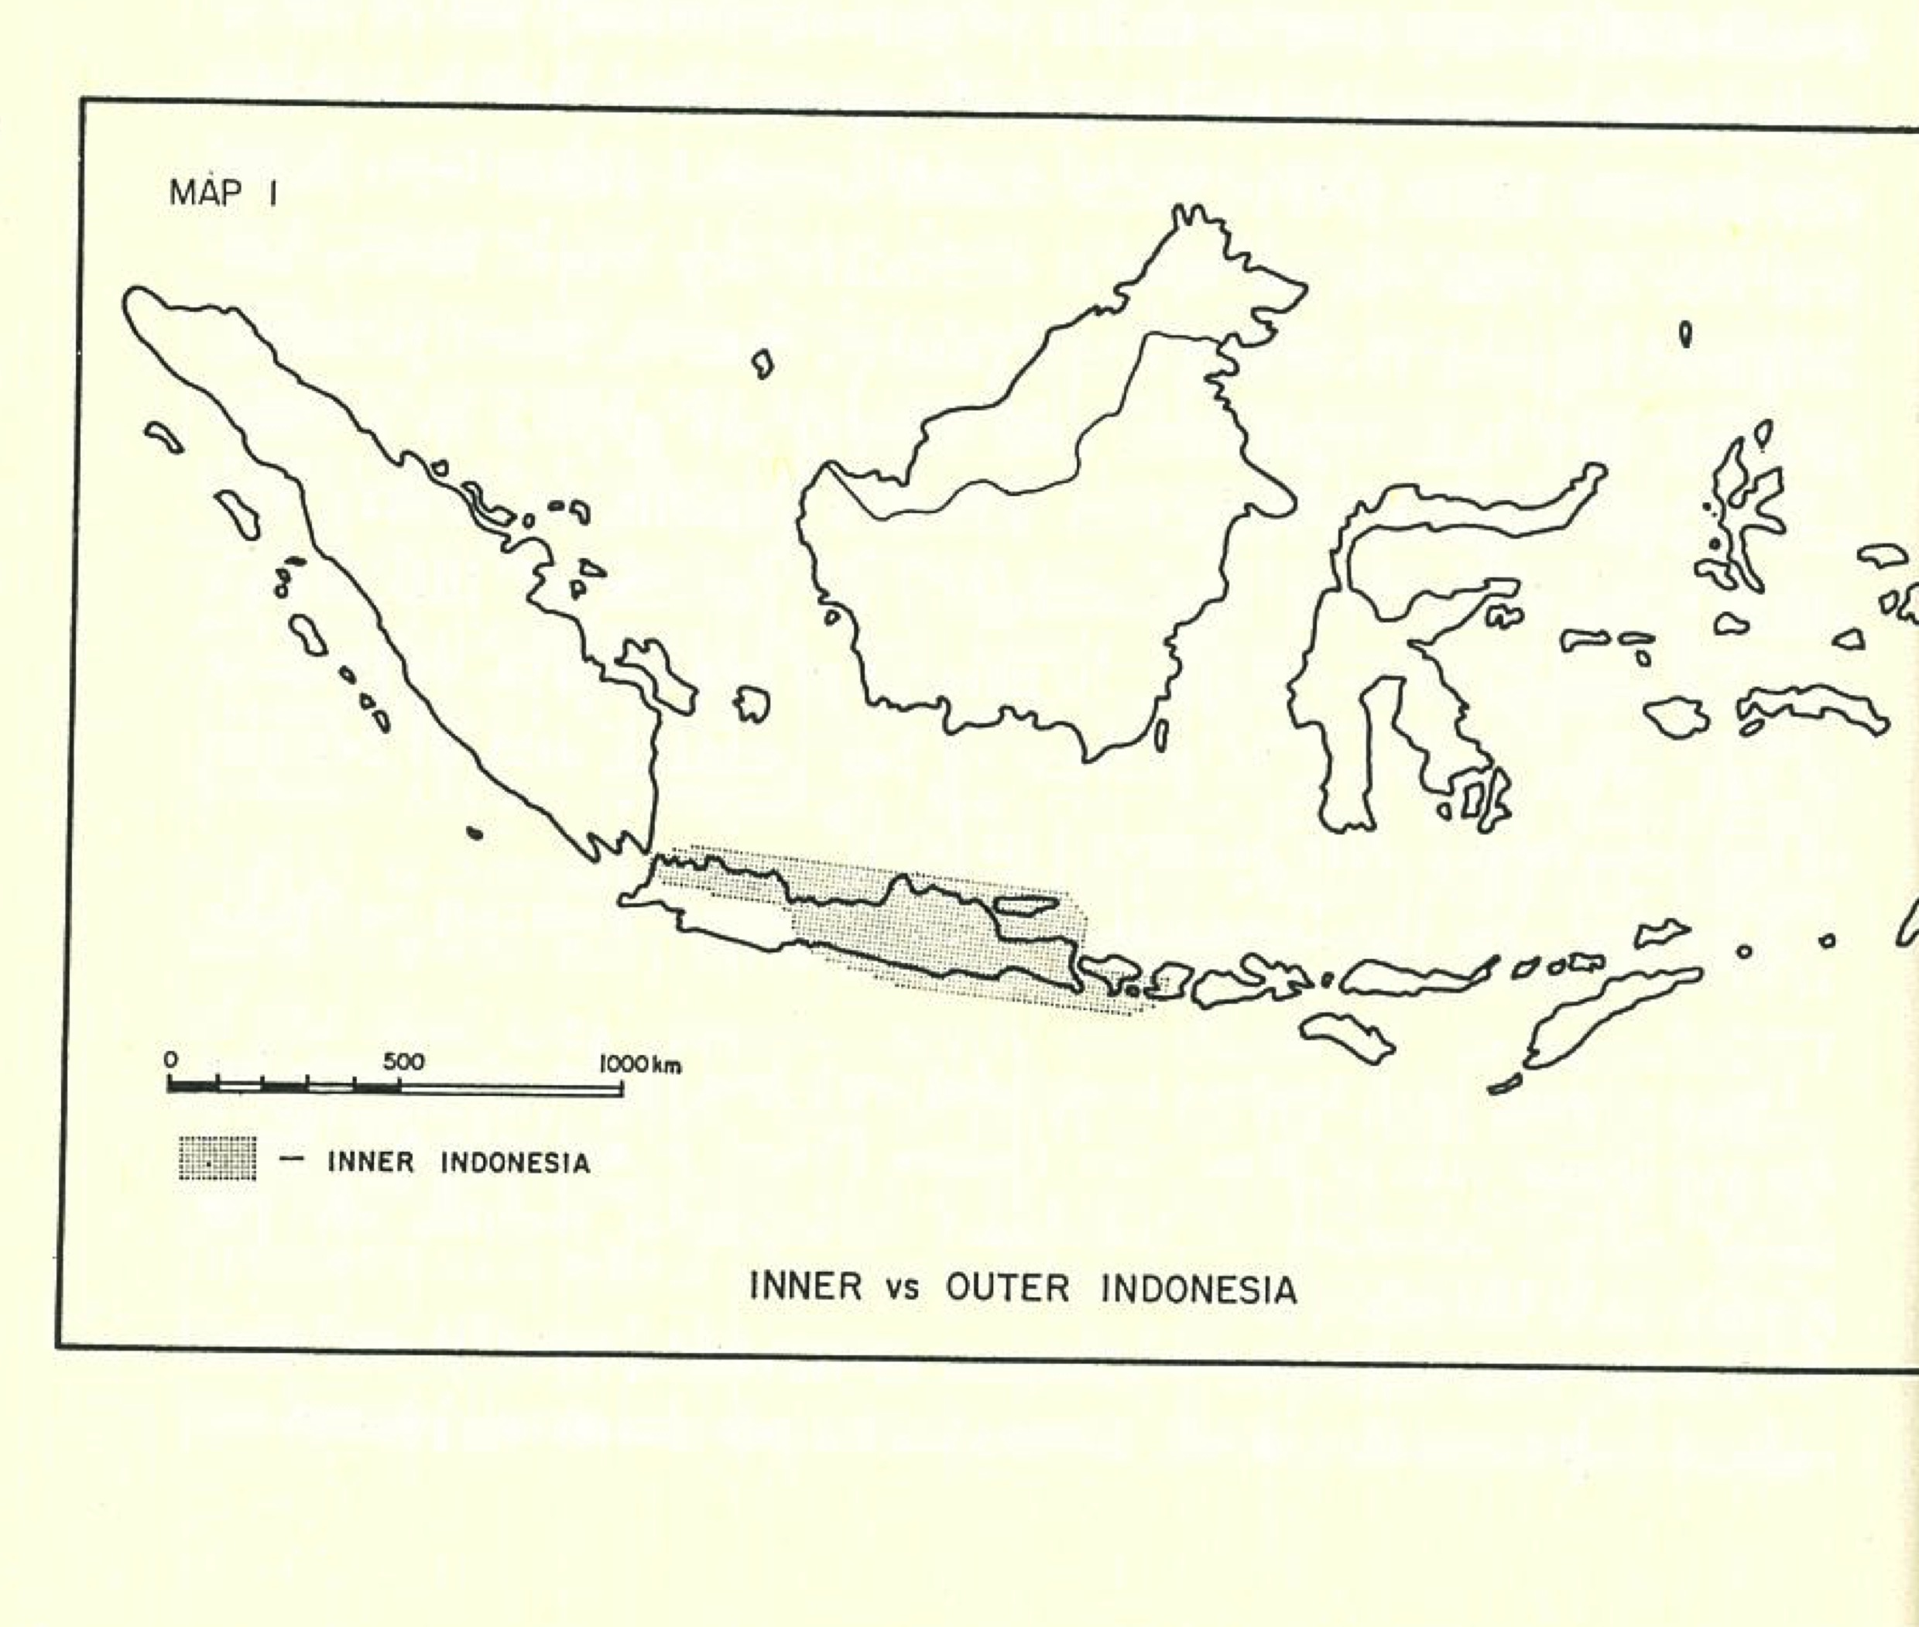

Slide 3
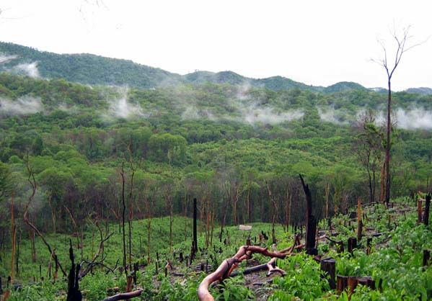
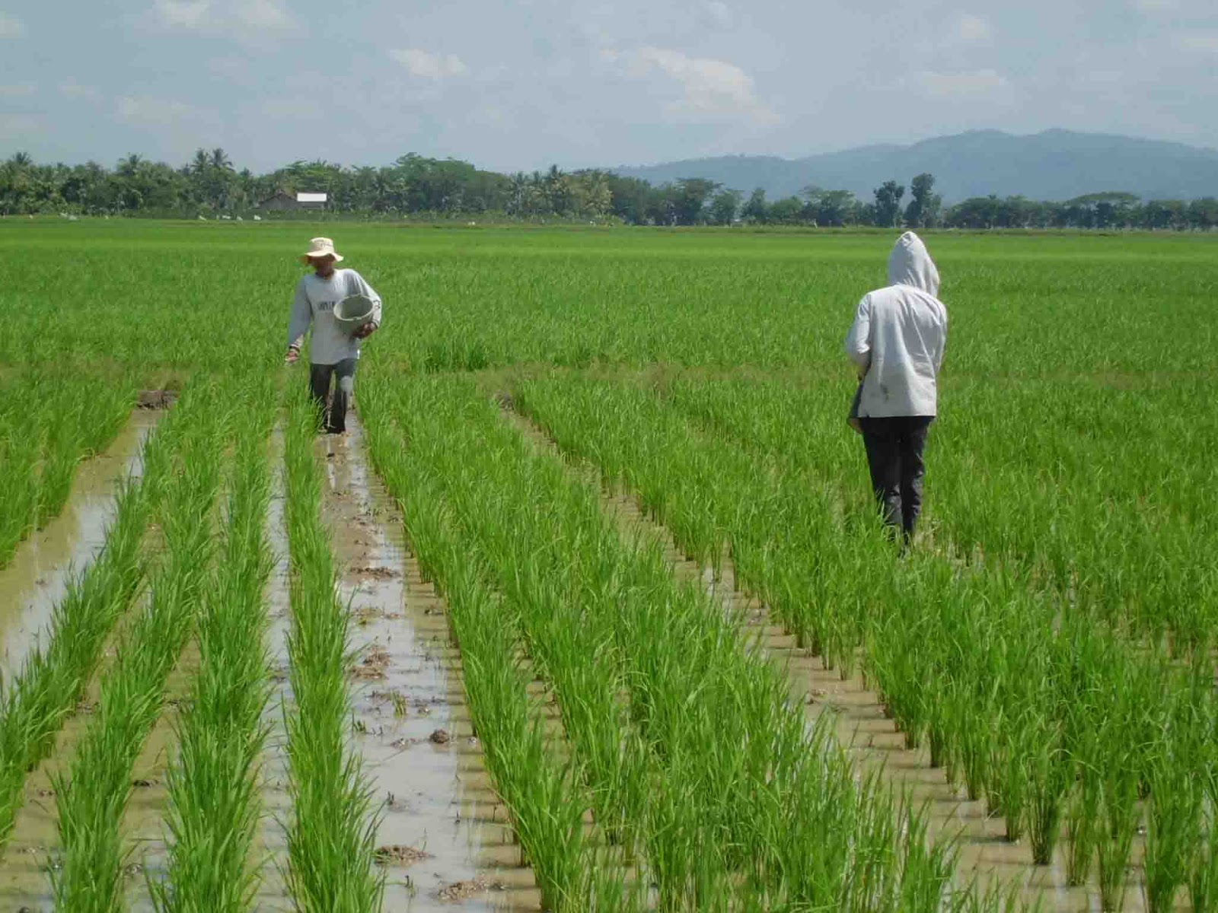
Two types of ecosystem
Swidden
Sawah

Slide 4
From ‘cultural ecology’ to ‘political ecology’
Humans have history
History = Change over time driven by human action
Power, inequality, domination
So how does history interact with cultural ecosystems?

Slide 5
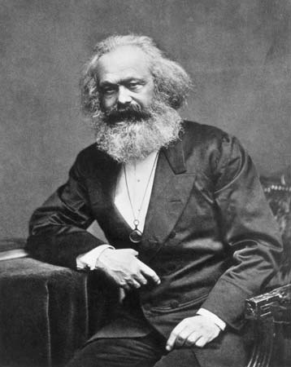
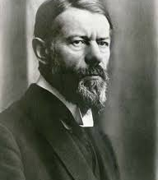
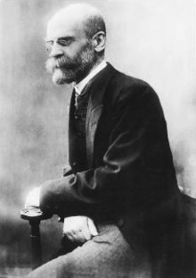
One Model: Modernization

Slide 6
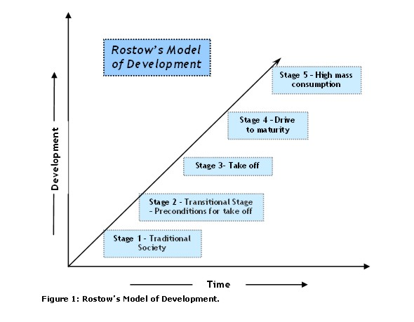

Slide 7
Weber’s theory of modernization
Why not China? Why not India?

Slide 8
Geertz’s question
Why not Indonesia?
Why Japan and not Indonesia?

Slide 9
